Slide 1


Data Analytics Project
Netflix Dataset
▶ PLAY
Staring: Aishwarya Chaubal
Aniketh Satyanarayana
Saurabh Somani
Veni Are
Genre: Data Analytics w/Python
Show : Final Project Presentation
Notes:
Creative Commons Attribution-NonCommercial-ShareAlike 4.0 International
EdTechPicks.org 2019-11-02

Slide 2
01
02
03
CONTENTS
04
05
Data Collection
Data Manipulations & Enrichment
Data Cleansing & Preparation
Visualizations & Regression Analysis
Conclusions

Slide 3
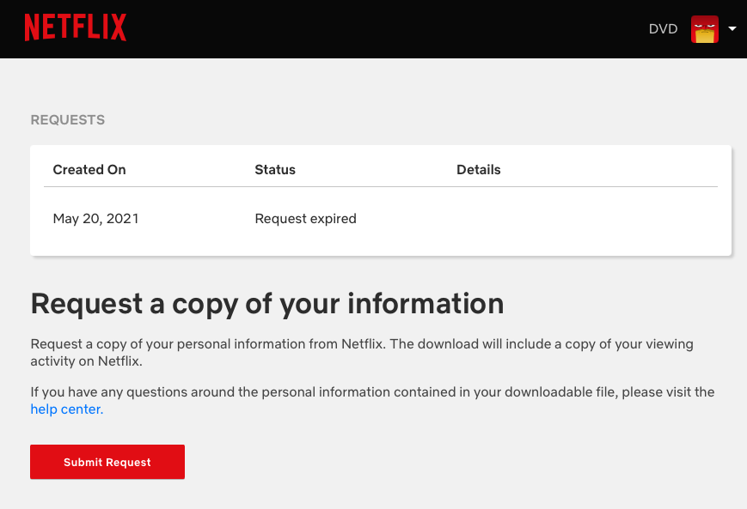
Data Collection
Data Source
Data Sets:
Viewing Activity: 7883 x 10
Search History: 260 x 9
Netflix Titles: 7788 x 12
Timeline: 2020-2021
https://www.netflix.com/account/getmyinfo

Slide 4
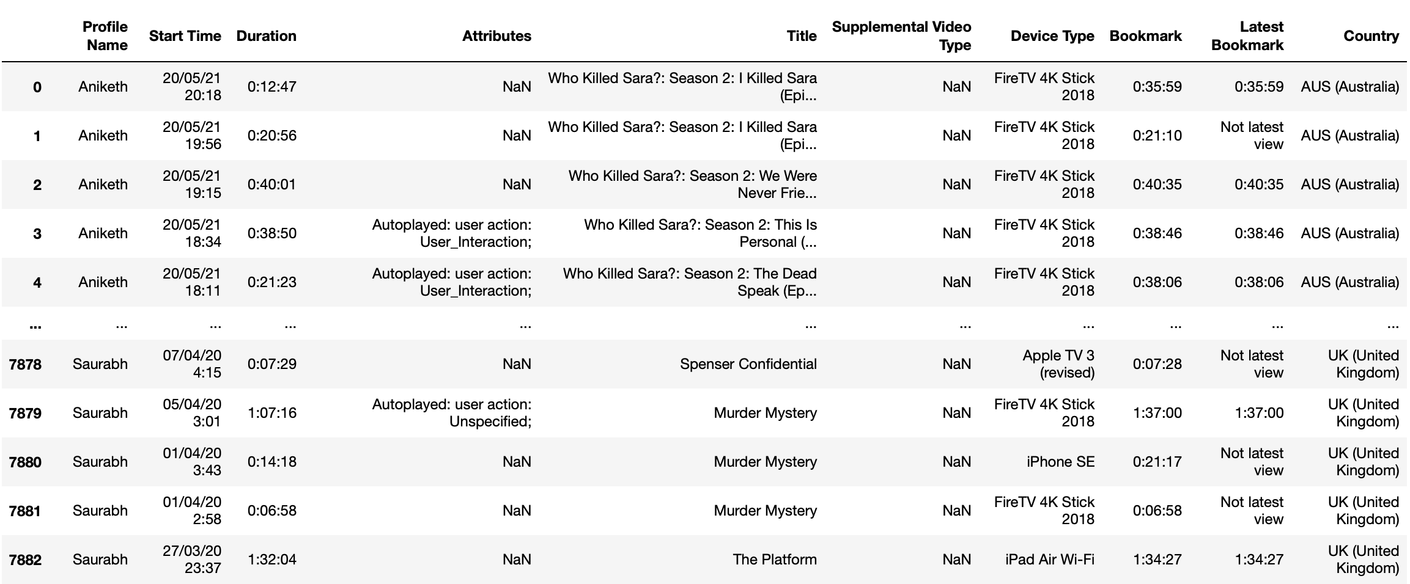
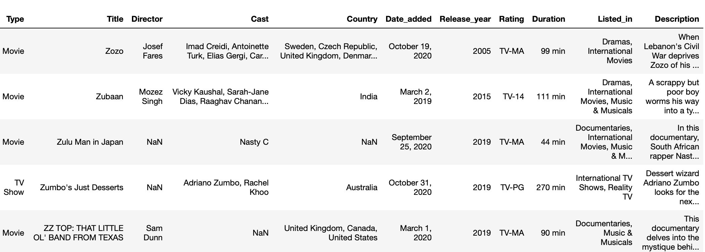
Data Cleansing & Preparation
A
Dropping unnecessary columns
B
Renaming Columns
C
Filling missing data

Slide 5
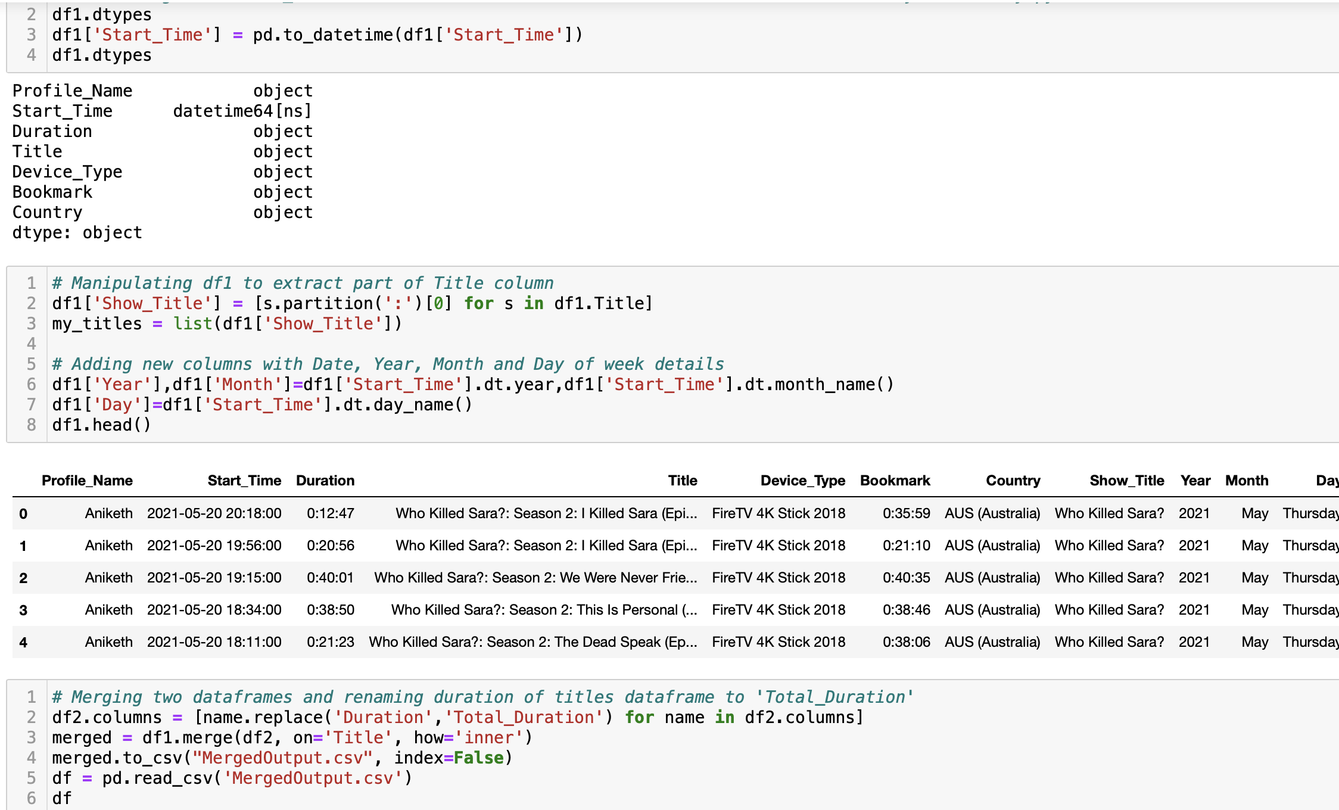
Data Manipulations & Enrichment
A
B
Changing data types
Adding new columns
C
Combining data frames

Slide 6
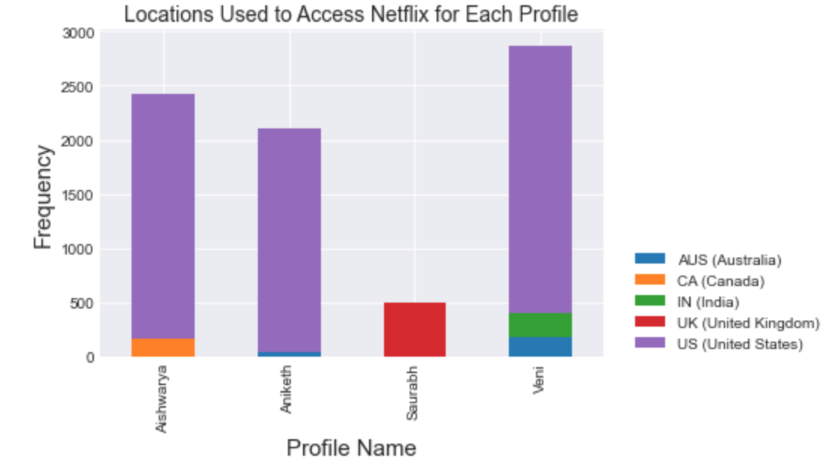
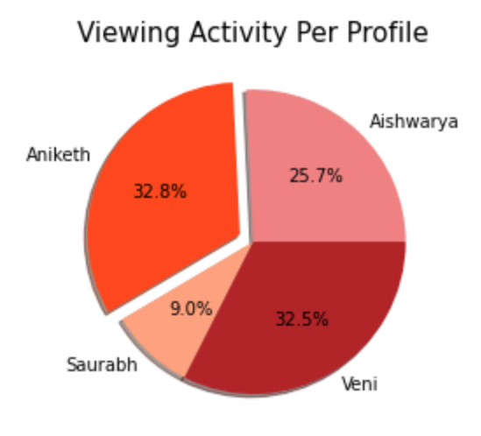
Visualizations & Regression Analysis

Slide 7
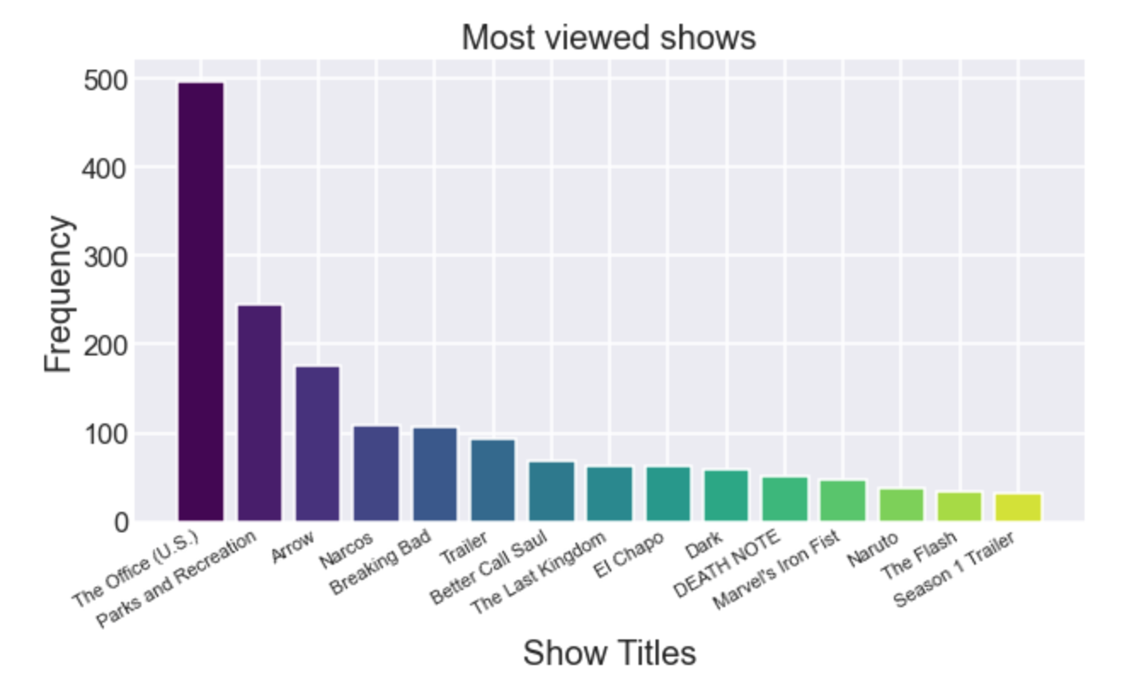
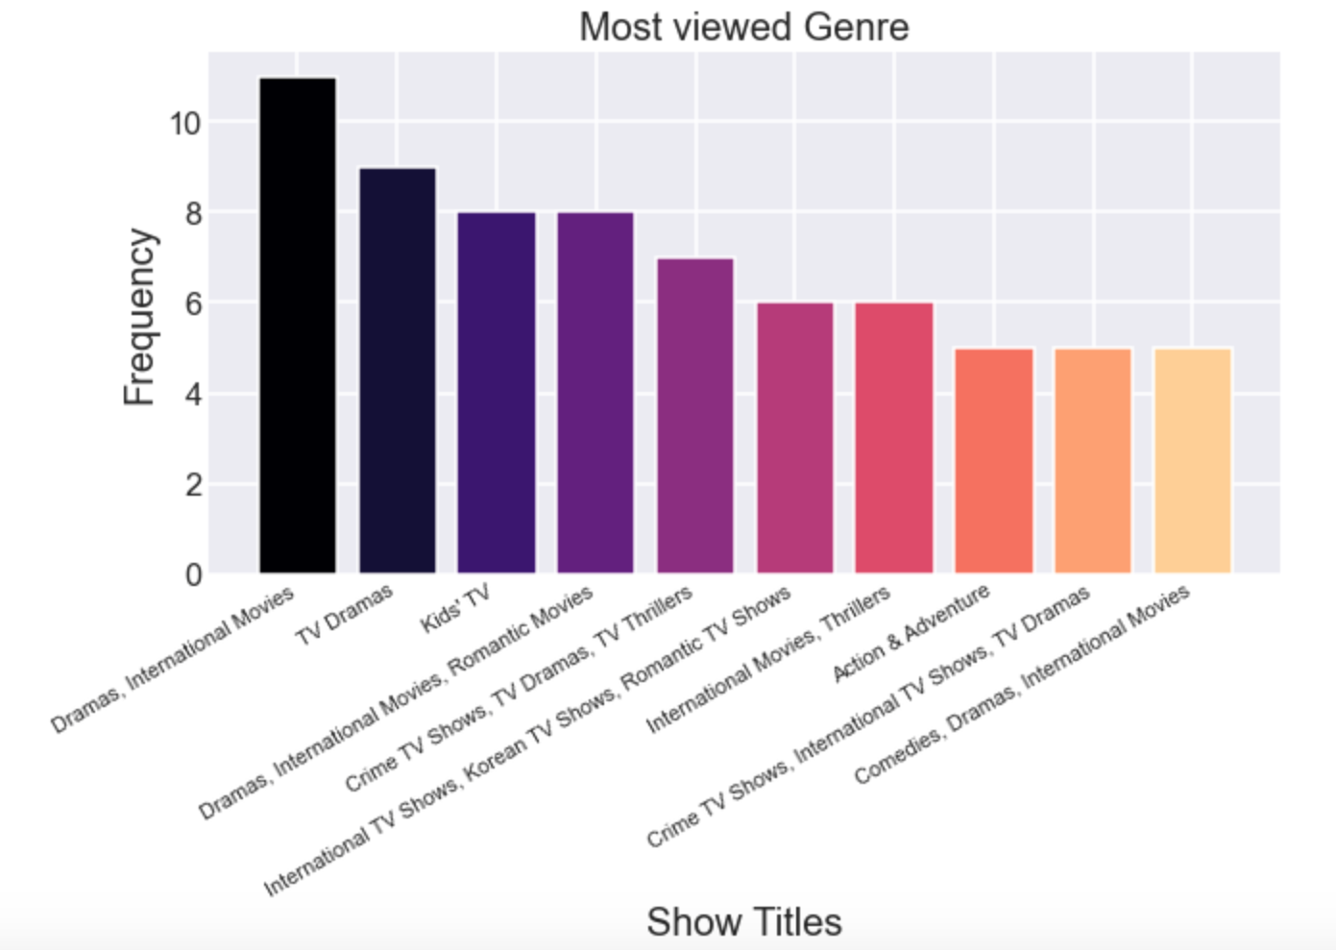
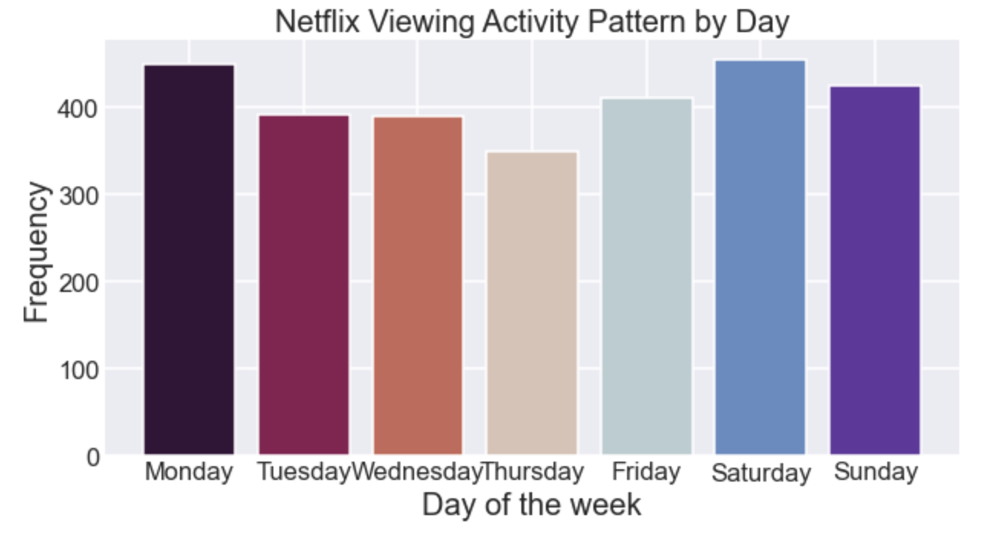
Visualizations contd..

Slide 8
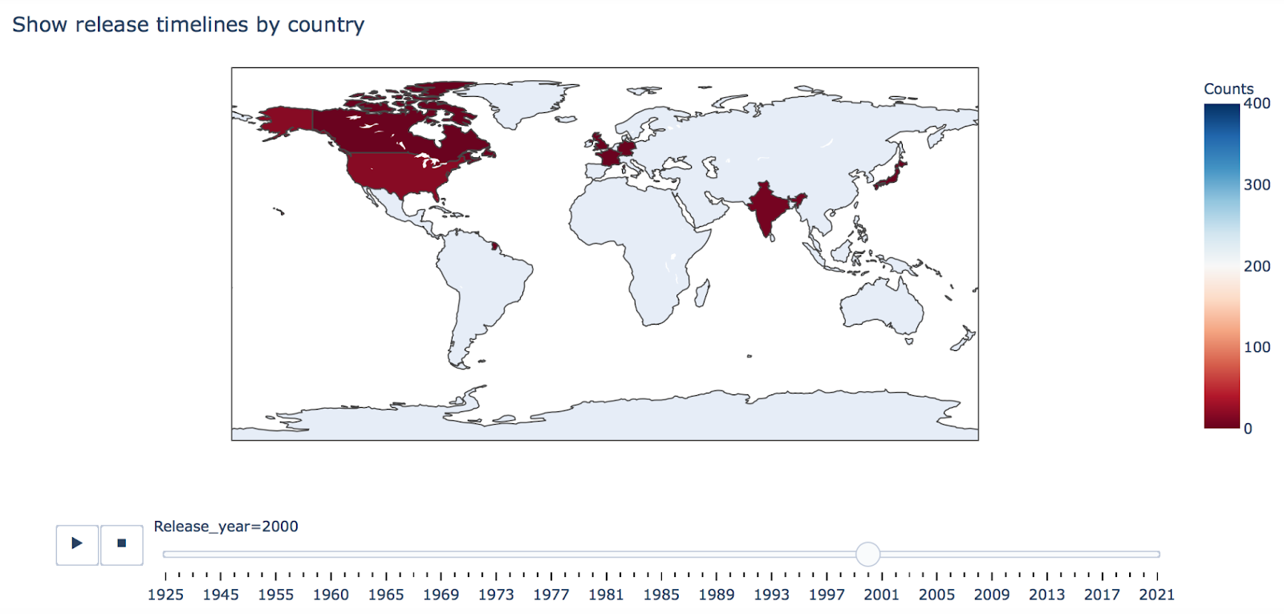
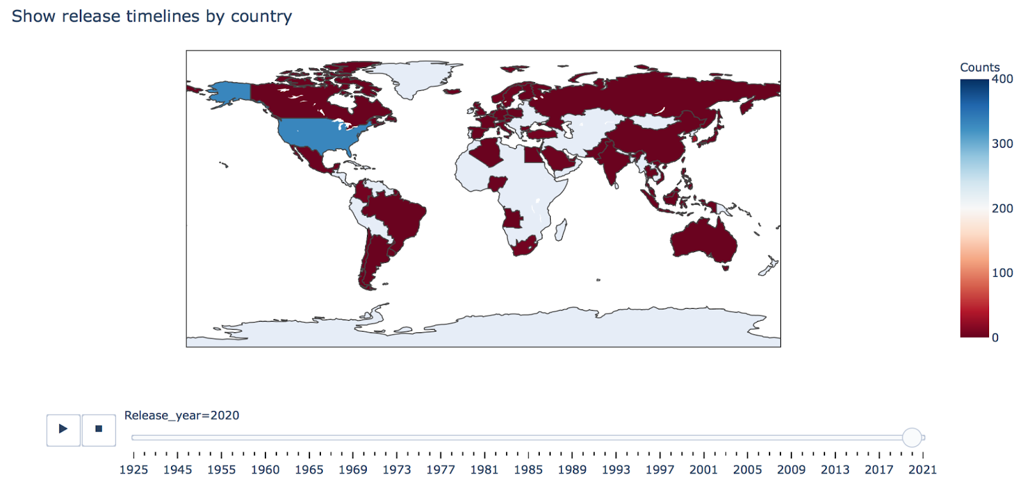
Visualizations contd..

Slide 9
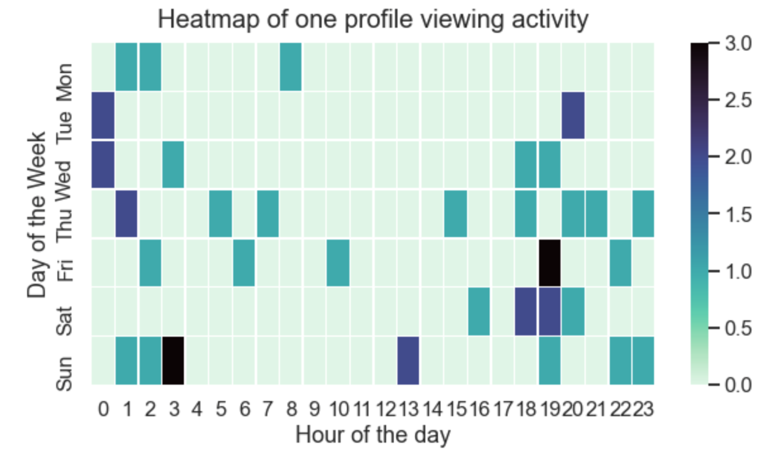
Visualizations contd..

Slide 10
Conclusions
We have drawn many interesting inferences from combining viewing activity dataset with Netflix titles. Here’s a summary of few of them:
Who watches the most Netflix? Inferred from the viewing frequency of each profile.
Since most of us are in United States, you see that we access Netflix mostly from USA.
Dramas and International Movies are the most watched genre’s.
From heatmap, we can see that most of the viewing happened during the evenings and late nights.
Netflix started gaining traction after 2010. Since then, the amount of shows added are being increased significantly overall world.

Slide 11

Do you have any questions?

